Slide 1
VETERINARY SURGERY COURSE
TOPIC:
ASEPTIC AND THEATRE TECHNIQUES

Slide 2
ASEPTIC TECHNQUES
Main objective
  Prevent infection
  Minimize bacterial contamination
Determinants of infection
  Host defense
  Physiological derangements
  bacterial contamination
  Presurgery, intraoperative & post surgery

Slide 3
Classification of surgeries
Clean surgery--GIT, urinary, respiratory not entered.
Clean-contaminated—entered but no significant spillage.
Contaminated—gross spillage of contents and acute inflammation occurs

Slide 4
Sources of contamination
Operating team
Patient
Surgical materials
Environment
Transient and Resident microbes- on and under the surface of the patient/ animal

Slide 5
Definitions
Aseptic principle
minimize or eliminate contamination by routine and standardizes preparation.
Asepsis
complete absence of living pathogens.
Sepsis
presence of pathogens and/or toxic products in tissue or blood

Slide 6
Definitions cont’d
Septic = infected
Sterilization
process of riding an object of all living microbes (pathogenic/non-pathogenic).
Sterile items = clean items
Unsterile items = dirty/contaminated

Slide 7
Definitions cont’d
Disinfection
destroying or inhibiting growth of vegetative forms of microbes.
significantly reduces contamination.
Disinfectant
destroys or inhibits growth of microbes.
used on inanimate (non living) objects.

Slide 8
Definitions cont’d
Antiseptic
destroys or inhibits growth of microbes on animate (living) objects.
Surgical scrub
removal of as many bacteria as possible.
mechanical washing .
chemical disinfection.
resident/transient microbes

Slide 9
Role of antibiotics
Never to cover carelessness.
Aseptic techniques to be strict and thorough.
Surgical techniques to be performed with precision and minimal damage.
Patient welfare
Correct dosage, correct time, preoperative or during surgery as Post Op Care.

Slide 10
Surgical conscience
Good aseptic technique
Good anesthesia
Dissection along tissue planes
Gentleness in tissue handling
Adequate haemostasis
Best surgical approach
Correct sutures and suture techniques
Shortest operating time

Slide 11
Methods of sterilization
Chemical
Gases
Radiation-ionizing radiation
heat

Slide 12
Chemical sterilization
Sterilize most items.
Not ideal.
Immersion.
Objects not withstanding high temperatures.
Depedends on level of chemical dilution.

Slide 13
Chemical sterilization cont’d
Advantages
no dullness or blunting.
Disadvantages
staining.
toxic residues.
not effective against sporulated forms.

Slide 14
chemical sterilization cot’d
Factors observed
effective concentration.
immersion and given period.
removal of organic matter (eg: Blood)-inhibit/inactivate.
Items must be handle as completely sterile.
Avoid contamination by careless handling.

Slide 15
Chemical sterilization cont’d
Immersion for given period depending on product is critical
Washing with sterile water to remove chemical ---toxic residues
Proper storage to avoid contamination

Slide 16
Ideal chemical
Kills all microbes + resistant forms.
Acts fast under wide range of T° + pH.
Exhibit extended residual action.
Non-corrosive.
Non-staining.
Stable solution.
No inhibition by extraneous organic matter
Not inactivated by other agents.

Slide 17
Common chemicals
Iodine and iodophors
e.g. povidone-iodine, tincture, Lugol’s.
Alcohols
e.g. 70% ethyl alcohol (surgical spirit), isopropyl alcohol.
Quaternary ammonium compounds.
Chlorhexidine HCl.
H₂O₂

Slide 18
Common antiseptics
Isopropyl alcohol/ethyl alcohol 70%
Advantages: protein denaturation, cell lysis, metabolic interruption, degreases the skin
Disadvantages: not effective against bacterial spores, poorly effective against viruses and fungi

Slide 19
Common antiseptics
Chlorhexidine gluconate (Nolvasan®), hibiscrub, hibiclen, savlon)
Advantages: rapid action, residual activity, less susceptible to organic inactivation compared to povidone-iodine
Disadvantages: skin sensitivity, no action on spores, variable action against viruses and fungi

Slide 20
Common antiseptics
Povidone-iodine (Betadine)
Advantages: bactericidal, virucidal, fungicidal (broad microbicidal activity)
Disadvantages: skin sensitivity, inactivated by organic debris, less residual activity than chlorhexidine, poor sporocidal activity

Slide 21
Heat sterilization
No toxic residues
Thermal death point
Active against sporulating organisms
Dry or moist heat

Slide 22
Dry heat sterilization
Longer periods
Destructive
Most items not able to withstand
1.Flame heating
2.Flaming spirit

Slide 23
Dry heat sterilization cont’d
3.Hot air ovens
slow temp rise and maintaining, slow drop
slow process
air flows freely within the oven
items should be clean and free of oily and greasy films.

Slide 24
Moist heat sterilization
More efficient and most commonly used in medical work
Sterilization at lower temperatures
Sterilization in shorter periods

Slide 25
1.Boiling in water
Limited use
Emergency situations when no alternatives
No absolute sterility (no guarantee)
Items absolutely clean
30 min of active boiling
Water boiling before immersion

Slide 26
Boiling in water cont’d
Sporulating bacteria resistant
Add 2% NaCO₃ assists killing of both vegetative and sporulating bacteria
Dullness and blunting of sharp objects
Rusting of non-stainless steel instruments

Slide 27
4.Steam under pressure
Use of autoclaves
Most efficient method
Moist heat at higher T° than boiling
Pressure increases T° (121-148°C)
Transfer latent heat of vaporization to the object which steam condenses on
Gradual heat penetration

Slide 28
Steam under pressure cont’d
10-15 min (minimum) of direct exposure to saturated steam at 121°C (minimum)
Oversterilization causes damage

Slide 29
Steam under pressure cont’d
Sterilization indicators
tape strips with chemical sensitive to heat.---inside and outside the package
colour change---white/cream-pink to black.
inside and outside the package.

Slide 30
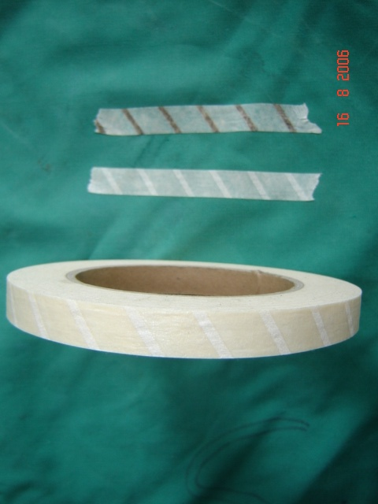
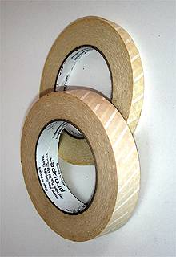
Sterilization indicator tape

Slide 31
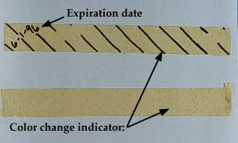
Colour sterilization indicators

Slide 32
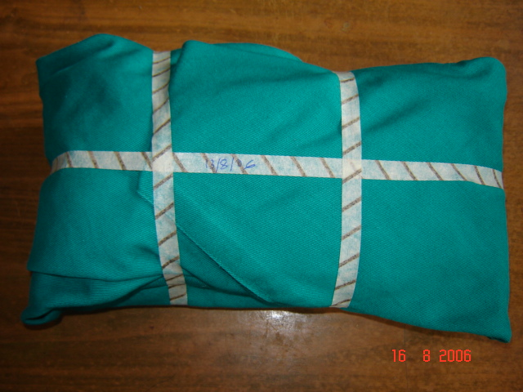
Surgical package wrapped and fastened with indicator tape

Slide 33
Causes of sterilization failure in the autoclave
Incorrect pressure gauge
Incorrect T°indicator
Air entrapment leading to dry heat
Improper packaging
Impervious wrappers
Improper loading in the chamber

Slide 34
Success of autoclave depends on:
Proper operation
Proper packaging
Proper loading-(relatively smaller loads compared to gas sterilization)

Slide 35
Gas sterilization
Ethylene oxide (EO or EtO)
Highly penetrating, colourless, toxic
Rapid penetration, flammable
Bactericidal and sporocidal.
Effective sterilization

Slide 36
Gas sterilization cont’d
Ethylene oxide cont’d
pH indicators similar to autoclave tape.
Effective at low T°- (25-60°C)
Heat labile materials. (4-16 hours)

Slide 37
Gas sterilization cont’d
Ethylene oxide cont’d
Clean materials into a tube of polyethylene or into plastic.
Gas-sealed instruments sterile for 6 months

Slide 38
Ethylene oxide cont’d
plastics, suture material, lenses and finely sharpened instruments.
Materials must be well aerated after sterilization.
Materials/instruments must be dry.

Slide 39
Sterilization by ionizing radiation
High energy ionizing radiation destroys microorganisms
Gamma (γ) irradiation
Heat labile materials or chemical sensitive
sterilize prepacked surgical equipment.

Slide 40
PACKAGING OF SURGICAL MATERIALS
Cleaned and dried
All materials entering the surgical field must be steriled
Packaged to enhance unwrapping
Packaged to minimize falling off
Those used first on top
Textile and paper materials “accordion pleat”

Slide 41
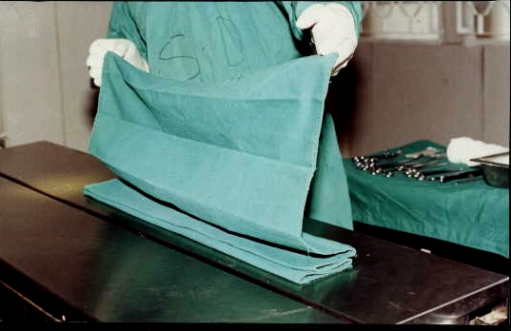
“Accordion pleat”

Slide 42
PATIENT PREPARATION
Medical evaluation, lab evaluation, anaesthetic and surgical risk patients.
Fasting 6-12 hours
Water not withheld.
Removal of gross dirt.

Slide 43
Operative site
Prepare prior to anaesthesia when doing regional and local anaesthesia
After induction for GA
Hair removal-clipping or shaving
Hair vacuumed or washed off
Washing with soap and water
Prepare an adequate area to avoid “break scrub”

Slide 44
Operative site cont’d
Surgical scrub of the area
Removal of gross dirt and water insoluble materials
Don’t brush but gauze
Outward circular motion and discard
Water-rinsing
Scrub solution with residual antibacterial effect- resurfacing flora

Slide 45
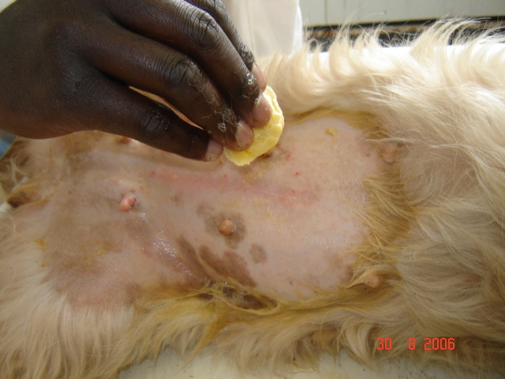
Preparation of operative site

Slide 46
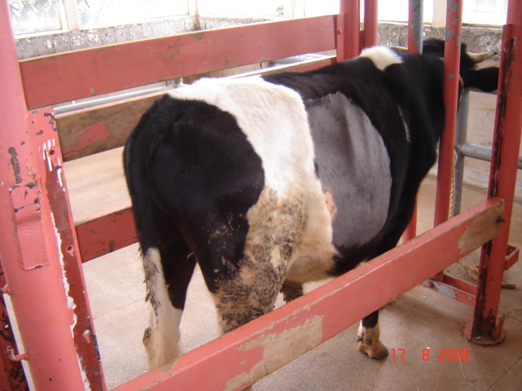
Preparation of operative site

Slide 47
Operative site cont’d
Fat-solvent germicidal
Germicidal applied with sponges-outward circular motion
Germicidal let to dry and not wiped
4 min for maximal effect
Bacteriological studies—germicidal with friction is more effective than aerosol

Slide 48
Operative site cont’d
Best germicidal is 1% iodine in 70% ethyl alcohol
70% ethyl alcohol---good and adequate germicidal but inactivates povidone iodine
Ready for draping.

Slide 49
Surgeon and operating team preparation.
Surgical attire
Scrub suit-clean not sterile
Cap or hood-clean not sterile
Shoes and shoe-covers
Surgical gown-sterile-autoclave
Surgical gloves-sterile-irradiation
Drapes- sterile-autoclave

Slide 50
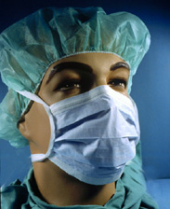
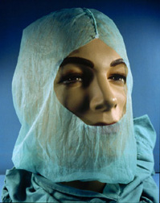
Cap and mask

Slide 51
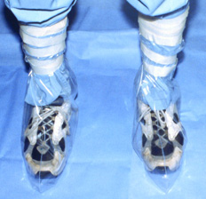
Shoe covers

Slide 52
Surgeon and operating team cont’d
Change from street clothes
Cap, mask, shoes
Shortened nails and dirt removal
Jewellery removal- watches, rings, bangles, necklaces.

Slide 53
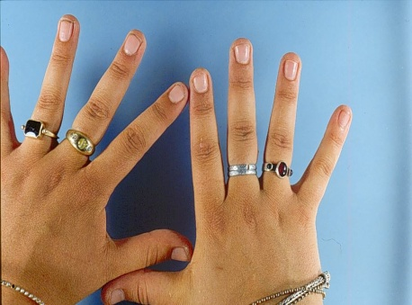

Remove jewels and clean nails

Slide 54
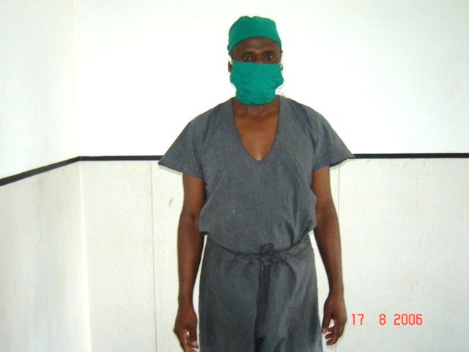
Scrub suit, cap and mask

Slide 55
Surgeon and operating team cont’d
Surgical scrub
Objectives:
Remove dirt, skin oil, grease, as many microorganisms as possible
Inhibit growth and propagation on skin for as long as possible
Universal purpose—prevent contamination and infection

Slide 56
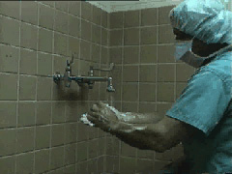
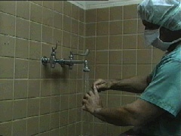
Cleaning the nails and washing hands

Slide 57
Scrubbing methods
Timed-anatomical
Counted brush-stroke
Done in blocks—hand divided into blocks---fingers, hand, forearm, rest of the arm.
Emergency scrub

Slide 58
Timed anatomical scrubbing
Systematic scrub
Foot, elbow or knee dispensers
Elbow tap operation
General hand wash
One hand first
Dispense soap
Each block and each surface

Slide 59
Timed anatomical scrubbing cont’d
Towards the elbow
The contralateral hand scrubbed
Both rinsed and ends one scrub.
Scrubbing repeated on both hands
Each ends distal to preceding one
3 complete scrubs per hand
3-5 minutes

Slide 60
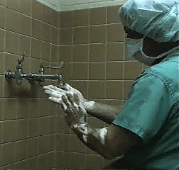
Surgical scrub

Slide 61
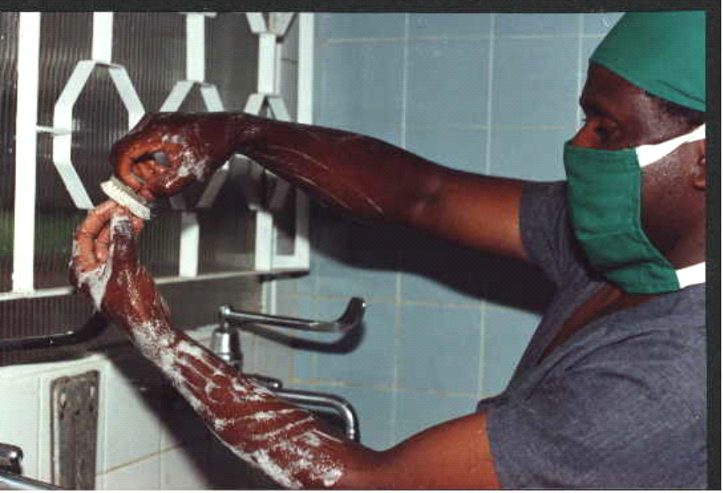
Surgical scrub

Slide 62
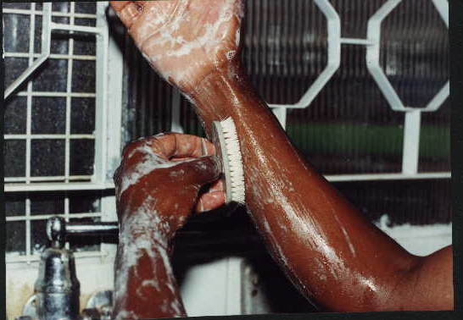
Progression of surgical scrub

Slide 63
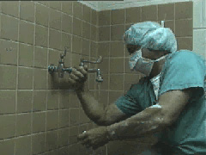
Rinsing

Slide 64
Timed anatomical scrubbing cont’d
Water drip at elbow
From beginning to end of surgery—hands above waist and below shoulder
Hand drying by sponging—exposure of deep seated resident microbes
70% ethyl alcohol rinse and let dry on

Slide 65
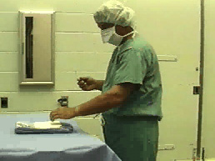
Taking the towel

Slide 66
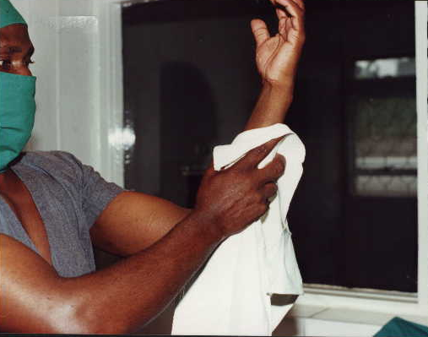
Hand drying by sponging

Slide 67
Emergency surgical scrub
General hand washing
In 70% ethyl alcohol for 1 min and let dry
NB: general rule
Touch anything-start over again
Scrub progressive-stop below previous
7 min active scrubbing

Slide 68
Counted brush stroke
Disadvantage- Loss of count
15-20 strokes per surface for whole scrub

Slide 69
Gowning
Accordion pleat
Folded inside-out
Drying towel together
Drying system
Pick and move off the table area and other objects
Sliding of hand into corresponding sleeve and assistant helping.

Slide 70
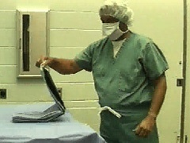
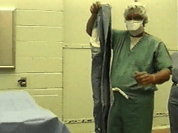
Picking the gown

Slide 71
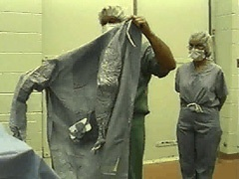
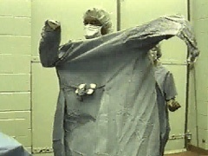
Gowning

Slide 72
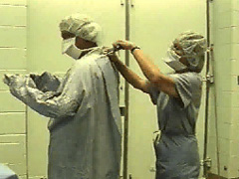
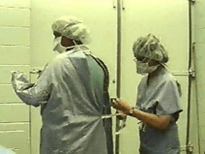
Tying the gown by assistant

Slide 73
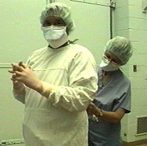
Gowning

Slide 74
Gloving
Sizes 6, 7, 7¹/₂ , 8
Two methods
Open and closed
Open gloving
Hands out of the cuff
Bare hands touch inside

Slide 75
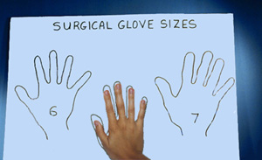
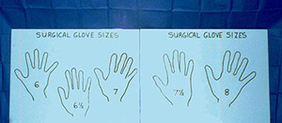
Glove sizing

Slide 76
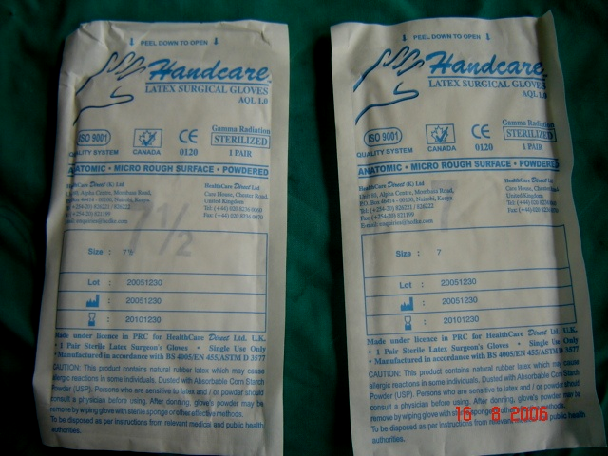
Sterile gloves

Slide 77
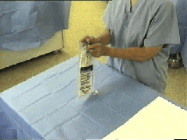
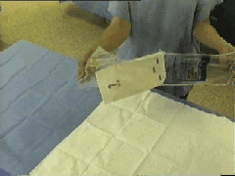
An assistant opening glove pack

Slide 78
Open gloving
Hands out of gown cuff
Cuff of glove folded inside-out
Bare hands touch the inside
Gloved hand hooks cuff of 2nd glove
Right-hand and left-hand glove
Powdered
Cuff of glove over cuff of gown

Slide 79
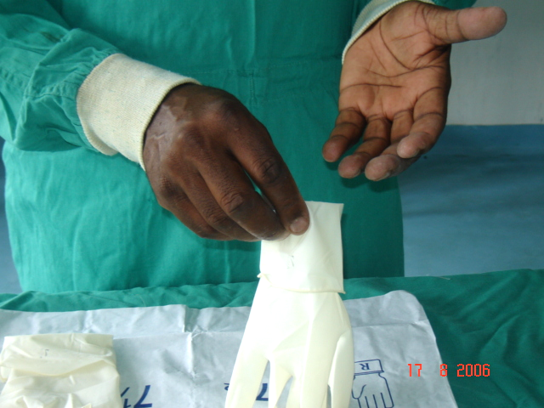
Open gloving

Slide 80
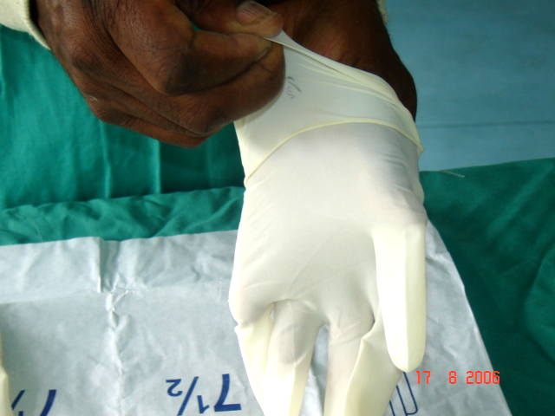
Open gloving cont’d

Slide 81
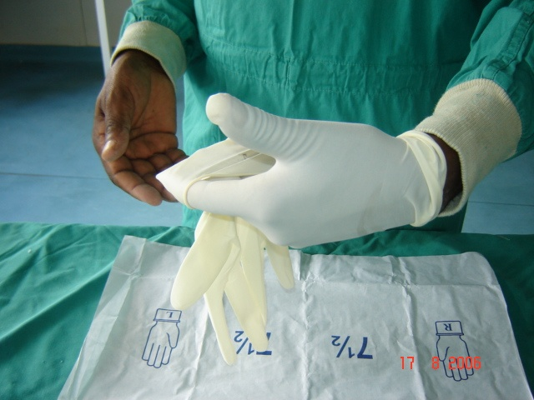
Open gloving 2nd hand

Slide 82
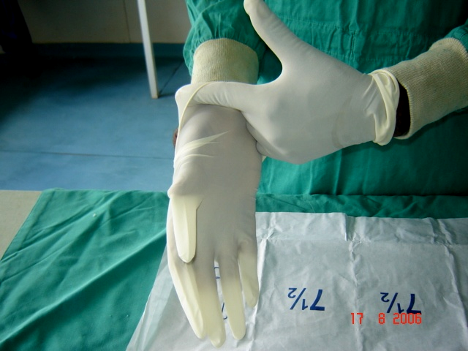
Open gloving 2nd hand cont’d

Slide 83
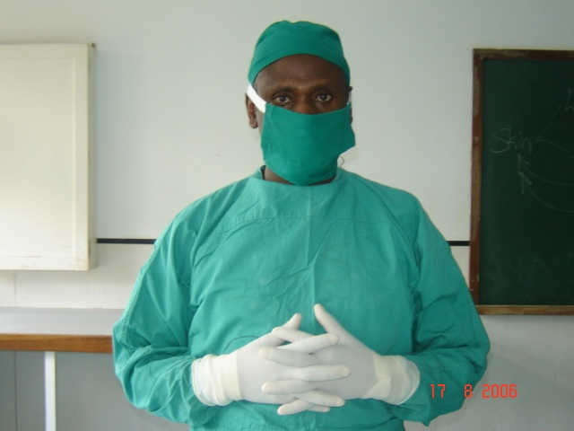
Surgeon fully gowned and gloved

Slide 84
Closed gloving
Hands under the cuff of the gown
1st hand-glove in the opposite direction
2nd hand assists to unfold the 1st glove
1st hand slid into the glove
Repeat on the 2nd hand
NB: punctured glove-change to new pair

Slide 85
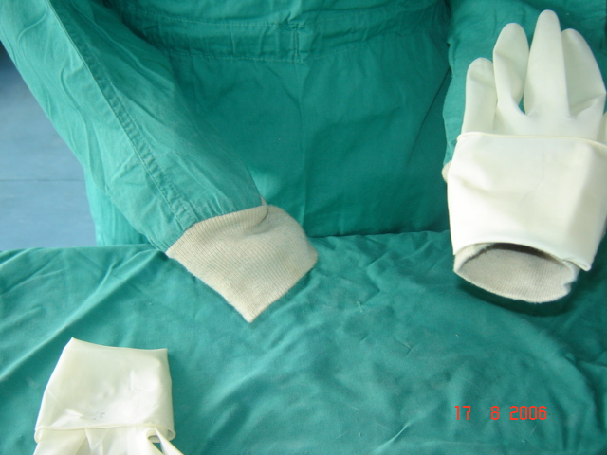
Closed-cuff gloving 1st hand

Slide 86
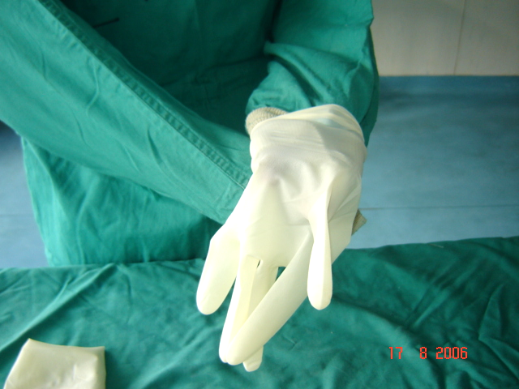
Closed-cuff gloving 1st hand cont’d

Slide 87
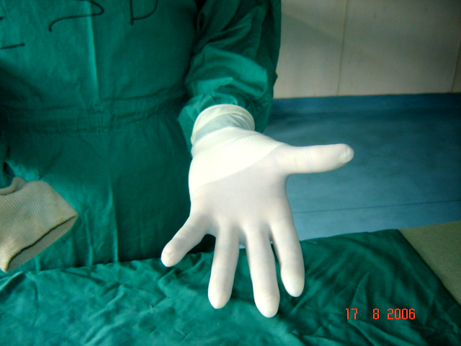
Closed-cuff gloving 1st hand completed

Slide 88
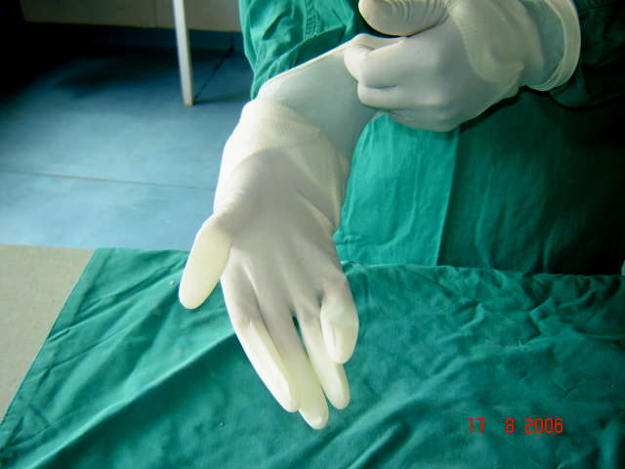
Closed-cuff gloving 2nd hand

Slide 89
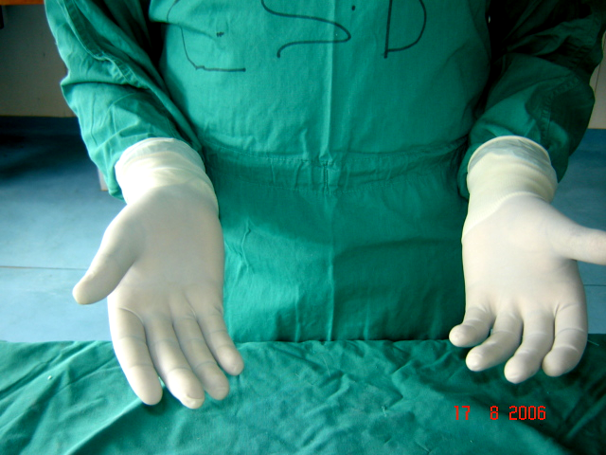
Closed-cuff gloving completed

Slide 90
Other members of the surgical team
Assistant surgeon (s)-just like the surgeon and conversant with procedure
Circulating or dirty nurse-scrub suit, not gowned or gloved
Anaesthetist-scrub suit only

Slide 91
Setting instruments on the surgical table
Opening the covering of the instrume t tray by-one not scrubbed
Inner wrapping by gloved assistant or surgeon
From tray onto the table
Handles facing the operating table

Slide 92
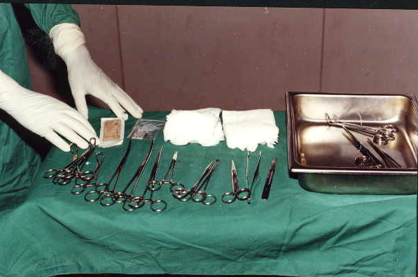
Setting of instruments on surgical table

Slide 93
Draping the surgical site
Sterile
Objective:
Increase sterile field
2 draping methods
Fenestrated
Four-corner

Slide 94
Fenestrated draping
Square or rectangular clothing with a fenestration at the centre
Fenestration directly over operative site
Anchored to the skin with towel forceps

Slide 95
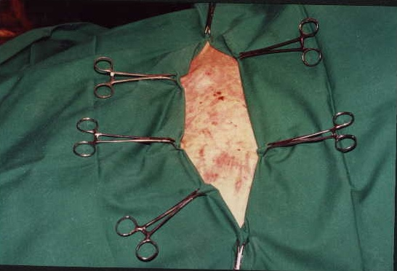
Draped operative site

Slide 96
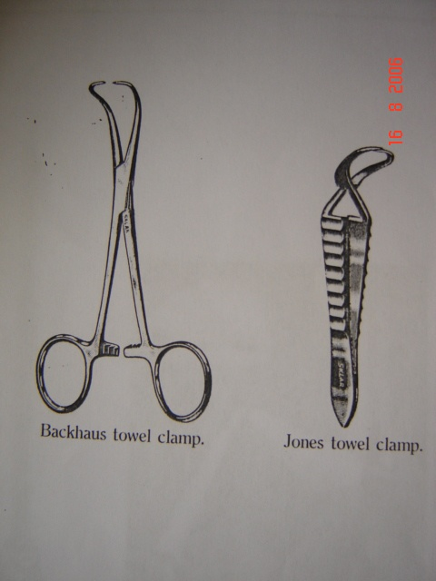
Towel forceps

Slide 97
Four-corner draping
Four square drapes around operative site
Area around covered but actual operative site uncovered
Ready for surgery
Green/grey

Slide 98
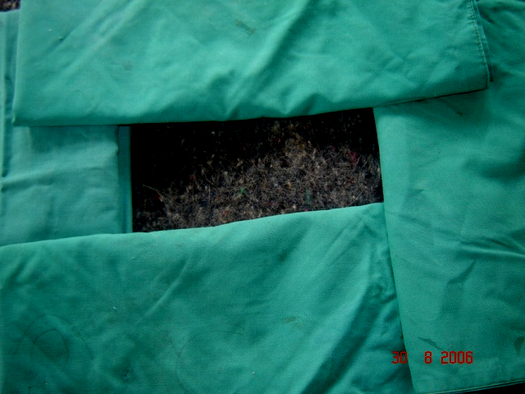
4-corner draping

Slide 99
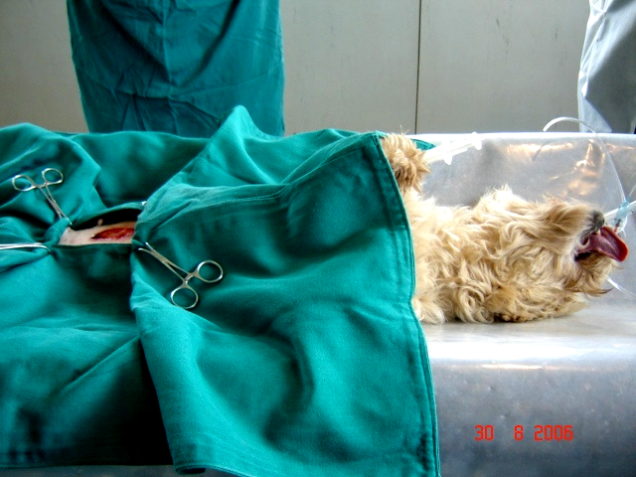
Patient positioned on surgical table

Slide 100
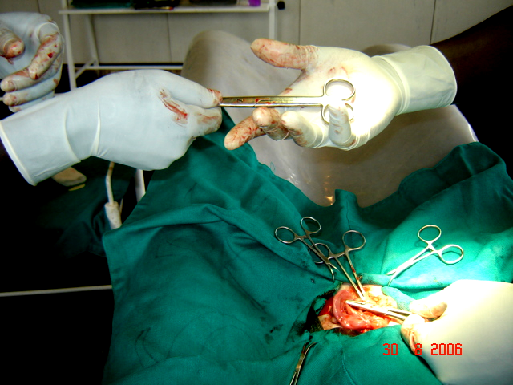
Handling of instruments during surgery

Slide 101
Operating room
Regular cleaning and dusting
Adequate and appropriate lighting
Adequate water outlets
Natural or artificial ventilation
Anaesthetic equipment and oxygen supply in working condition
Doors closed. Prep room next.

Slide 102
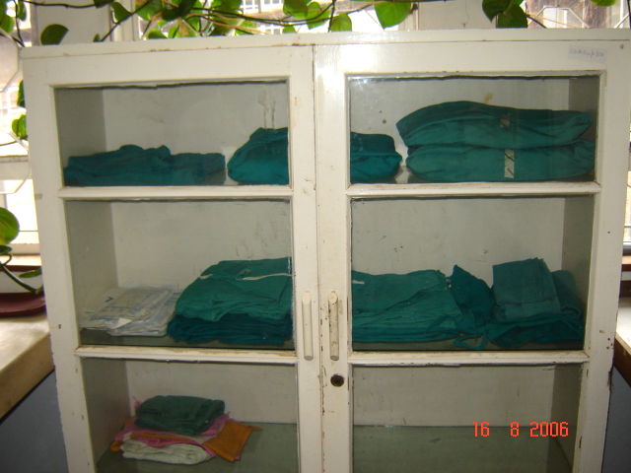
Cabinets in the preparation room

Slide 103
Precautions to maintain sterility
Sterile surfaces to sterile articles
Unsterile surfaces to unsterile articles
Violation compromises aseptic principle
No turning of backs to sterile surfaces
Sterile instruments never below edge of the table
Arms and hands above waist and below the shoulder

Slide 104
Precautions cont’d
Front of gown between waist and shoulder considered most sterile
Lift instruments do not drag them
Sterile surfaces dry
Saline bowl in the instrument tray
Avoid excessive movements
Avoid shaking of surgical clothing

Slide 105
Precautions cont’d
Conversation minimal
Clasping of arms in front above waist

